Slide 1
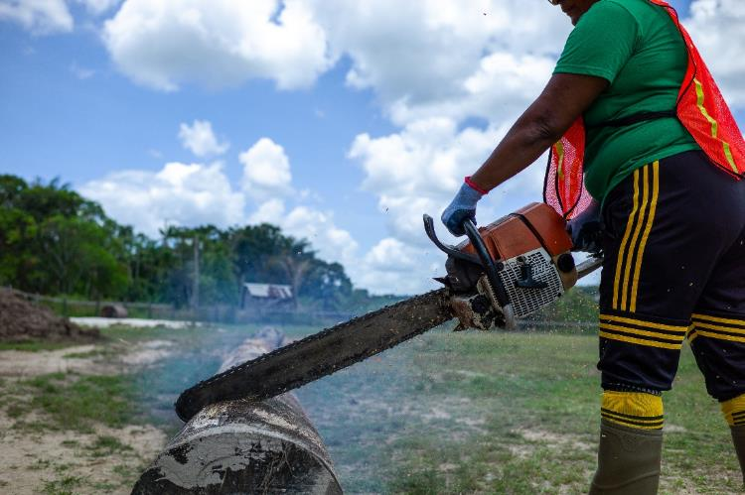
Gender-Analysis of Forests & Forestry in Guyana
Presented by: Salima Bacchus-Hinds
The Guyana Forest Group
September 2023

Slide 2
Acknowledgements
We would like to acknowledge the contributions of:
Heetasmin Singh, The Yarrowkabra Coal Burners Association, Mainstay/Whayaka, Three Friends, Coomacka, The FAO, The Consultancy Group, GFC, News Room, and the community data collectors

Slide 3
Background
There are significant gaps in research to understand the relationship between gender and the forests, particularly the roles and responsibilities of men and women and their influence on forest operations throughout Guyana’s timber supply chain.
Data is vital to improving forest management policies so that women and youth from forest-dependent communities, including but not limited to Indigenous communities, can have more equitable access to forest resources and benefits, such as opportunities in employment, ownership of assets and capacity building development.

Slide 4
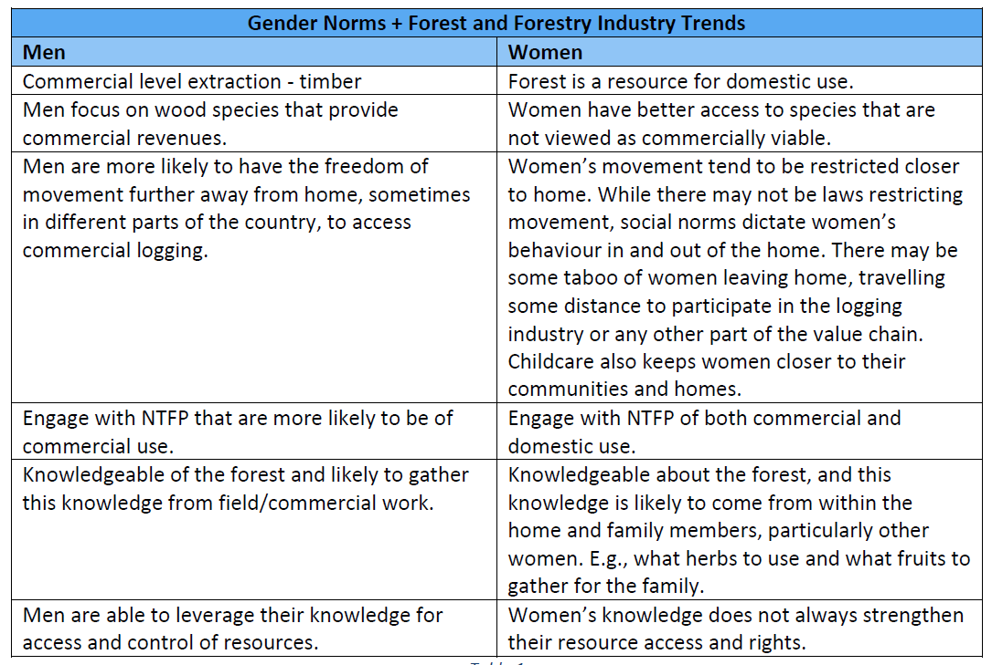
Global Trends

Slide 5
The Guyana Context
Many of the forest dependent communities are less densely populated and are home to most indigenous persons living in Guyana.
Forest-dependent/hinterland communities are faced with higher poverty levels than their counterparts on the coast.
Women and girls experience higher unemployment than men and boys.

Slide 6
The Guyana Context
Guyanese women and girls represent just over 50% of the population, and yet are under-represented in the labour market. This is even more stark in the male-dominated industry of forestry.
Women’s and girls’ care work keep them in the home, and other cultural norms dictate how, where and when women work.

Slide 7
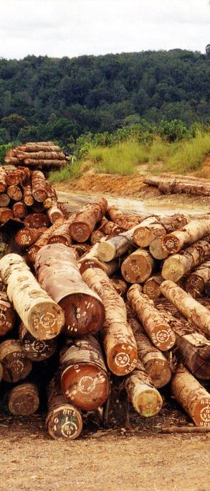
The Guyana Context cont’d
The forests provide resources and space for a number of industries in addition to logging. These include conservation, research, tourism, agro-forestry, craft, charcoal.
The way men and women interact with the use, management and conservation of the forest varies comparatively.
Wider social norms around work and gender, means that men and women are represented at different places along the value chain.
This Photo by Unknown Author is licensed under CC BY-SA-NC

Slide 8
Why A Gender Lens?
Gender norms can determine who has a say, who has access to resources and who makes the decisions about the use and management of those resources.
The analysis looks at the relational and power dynamics of both men and women in their communities.
A gender analysis helps to identify the unique experiences and reveal gendered opportunities and restrictions that both men and women face.

Slide 9
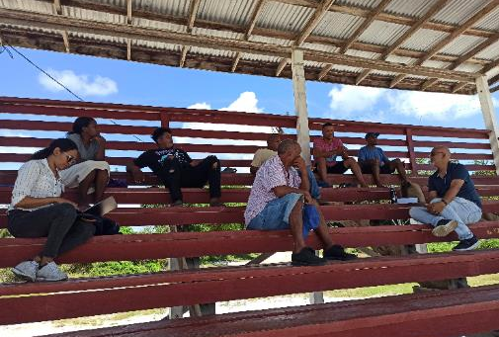
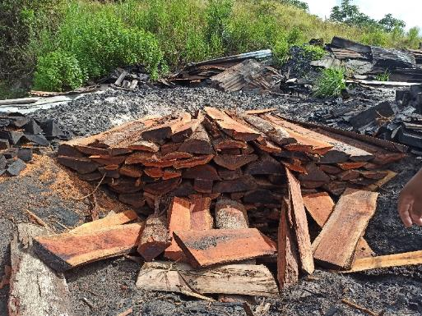
What Does the Data Say?

Slide 10
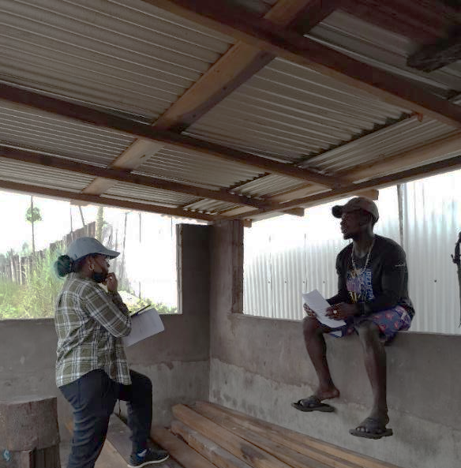
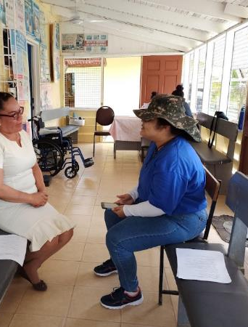
Overview of the Study
Supported by the FAO
Data Collected from:
Mainstay/Whaka
Yarrowkabra
Coomacka Lands
Three Friends/De Maria Elizabeth
150 Household Surveys
3 Focus Group Discussions

Slide 11
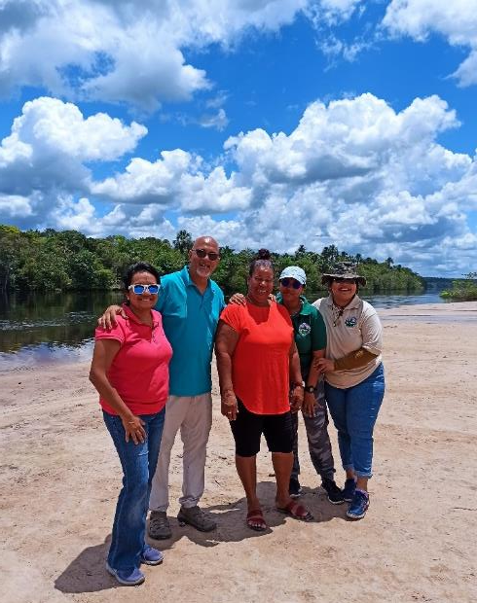
Community Data Collection
Data collected under six major sections:
Demographics
Access to assets
Knowledge, belief and perceptions
Practice and Participation
Time and Space
Balance of Power and Decision-Making
Notes:
Access to assets - how does gender shape access (opportunities and barriers)? Are there gender-specific assets? How do women and men use assets differently?
Knowledge, beliefs, and perceptions - How do knowledge, beliefs and perceptions shape the notion of gender? How does gender shape learning and acquisition of knowledge?
Practices and participation - What is the gender division of labour? How does gender shape participation (or exclusion) in activities?
Time and space - How do men and women spend their time, and where?
Legal rights and status - How do legal frameworks provide opportunities and barriers for men and women?
Balance of power and decision making - Who has the power to make decisions at the individual, household, community, regional, national levels? How are men and women represented in decision-making spaces?

Slide 12

Demographics
Almost equal number of men and women surveyed (50.7% and 49.3%).
68.2% lived 15+ years or all their lives in the community
Women more likely to be employed in public sector than men.
Men more likely to have a self-owned business than women.

Slide 13
Demographics cont’d
Majority of employed men and women were employed full-time (36.4%)
11% of women surveyed were homemakers vs less than 5% of men (homemakers as primary occupation)
Education and health workers (women) were all tertiary educated
Women more like to finish secondary school and enroll in tertiary programmes.

Slide 14
Access to Assets
More men reported the forest contributes to family and personal income than women did.
All categories of forest products used in home
More women used NTFP in the home than men (who used more timber).
More men than women make money from timber. (Includes logging, sawmilling, charcoal production)
Notes:
What opportunities there for women and men
NON-timber forests used by women more

Slide 15
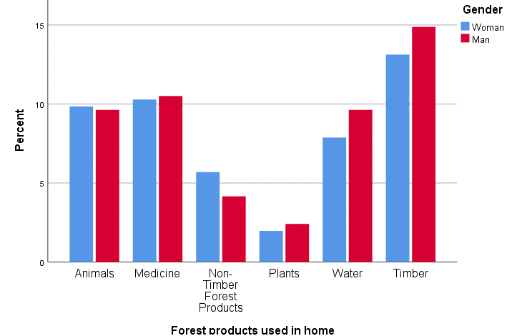
Access to Assets cont’d
Notes:
What opportunities there for women and men
NON-timber forests used by women more

Slide 16
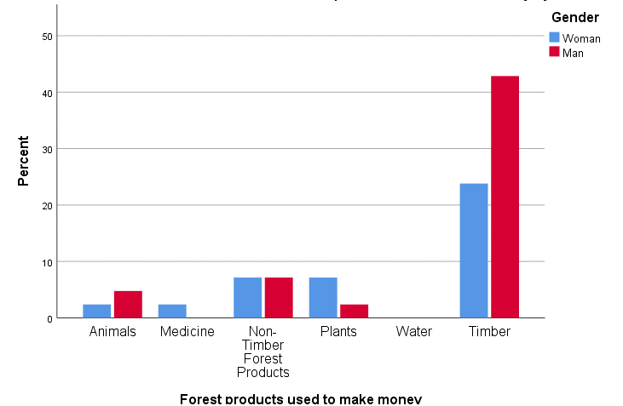
Access to Assets cont’d
Notes:
What opportunities there for women and men
NON-timber forests used by women more

Slide 17
Knowledge, Beliefs, and Perceptions
The following were some prevailing sentiments regarding gender and forests:
The forest is more for men than women.
Men better manage the forests.
Women make good decision-makers for community, home and business matters.
Training women for forest sector would be easy.
Women can handle forest work.
Forest work is dangerous for everyone.
There is a willingness found in women to participate more in the forest sector.

Slide 18
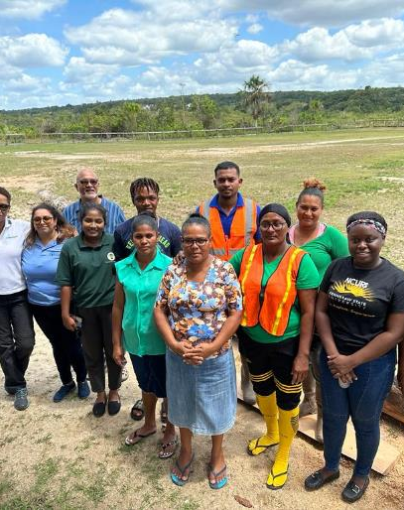
Practices and Participation
Most respondents were part of a community group
Women’s groups largely focused on community development or other economic activity (crafts, agriculture)
Women in leadership positions in all communities

Slide 19
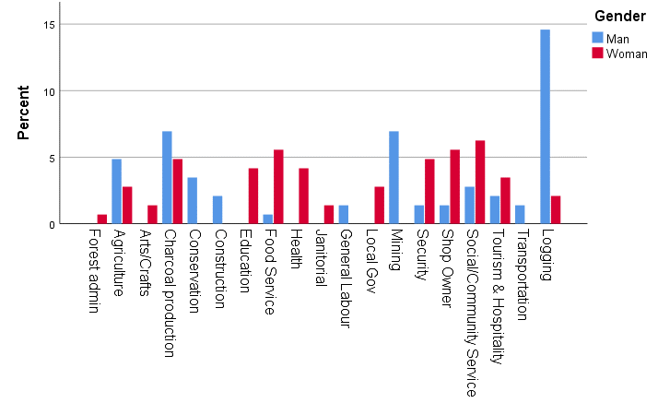

Slide 20
Time and Space
Overall, women spent more time on housework than men, even when they were employed full-time. Some full-time employed women reported spending more than 8 hours a day on housework.
Full-time employed men spent on average 0-4 hours on housework. Men spent more time on work outside the house.

Slide 21
Balance of Power & Decision Making
Child and family care, children’s schooling were perceived as decisions women made.
Limited livelihood options led to women involvement in charcoal production and other extractive
Women were involved more in the administrative duties of CFOs, with exceptions where women were also involved in laborious work or operations in the concessions.
At a community level, women are represented in leadership positions in all locations.

Slide 22
Recommendations that emerged
Women-focused training in inventory, sustainable logging, and administration in the forest sector.
More safety training for the forest sector.
Machinery and equipment training for women in forests
Charcoal production training for women groups
Development of industries: tourism, agriculture, furniture-making, crafts, sewing and tailoring

Slide 23
So why is this data important?
Mainstreaming gender in the forestry sector, serves as an avenue for women and youth to have greater say in their community development, and access to socio-economic resources that increases their autonomy. Projects and interventions that’s are gender sensitive.
Recognise and support women’s rights in forest-dependent communities.
Reveal gender dynamics within a community, and how natural resources shape and influence community relations and vice versa.

Slide 24
So why is this data important?
Promote gender equity at various levels of the forestry sector.
Contribute to the expansion of local ecological knowledge.
Ensure women are in leadership/decision-making positions and are actively involved in forestry management and conservation.

Slide 25
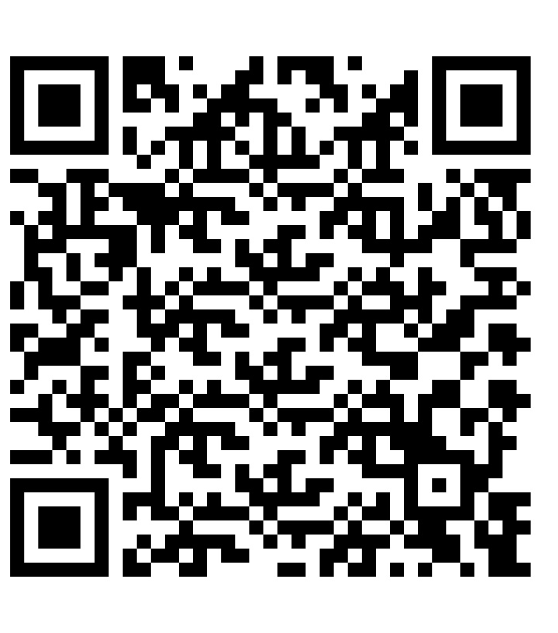
The End

